Slide 1
Pls 2000 power & politics Dr. shannon
Critical Theory & Its Critics

Slide 2
CRITICAL THEORY & ITS CRITICS
I. CRITICAL THEORY
II. CRITICS OF CRITICAL THEORY
TERMS TO KNOW
Critical Theory Cancel Culture
Cultural Hegemony Punching Up v. Punching Down
Antonio Gramsci Paradox of Tolerance
False Consciousness

Slide 3
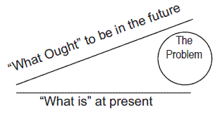
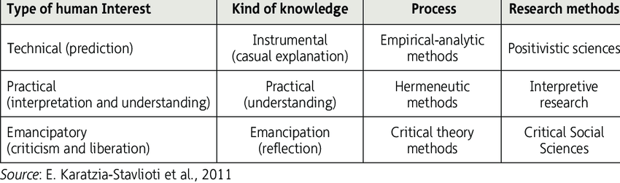
Normative VS. EMPIRICAL ANALYSIS REVISITED
Normative: what ought to be (identify what is good…recommending what we ought to want)
Empirical: what is (studying observable things to see how things really are; what is true)
Scientific Approach (uncover laws of cause and effect that explain patterns of political behavior across time and space)
Anthropological Approach (understand and interpret how others in a particular time and space see the world)
Critical Theory (reveals and “deconstructs” what is seen as normal or natural to be a hegemonic but changeable force of oppression and marginalization, so to emancipate those disadvantaged by it
Notes:
Critical theory: takes a critical look at the current world to see that it is not inevitable but is changeable, says that in the current world there is power that corrupts and oppresses, and attempts to emancipate the oppressed.

Slide 4
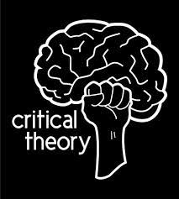
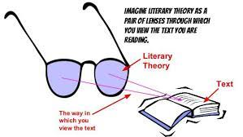
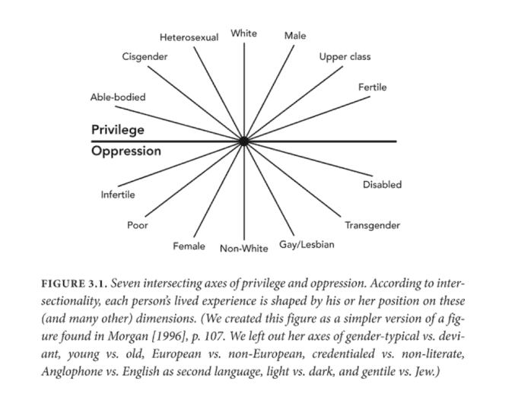
PREMISES OF critical theorY
No Natural Individual or Essential Self: we are products of environment and power
Subjectivity: one’s experiences and perceptions matter and are valid, and have a right to be heard and respected
there is not objective truth but only social constructions of reality based on rules, laws, texts and words that define identity and value
Words (texts) matter: literary criticism as politics – all words judged for their role in shaping power, identity, values and rights
Extreme Form: knowledge is a product of power and knowledge is used to perpetuate power and powerlessness. Aim is “to significantly change socio-political-cultural orders” (Merrick and Hedges 2021)
Relativism: standards of rightness are relative to one’s culture and experiences, which can vary
Extreme Form: there are no absolute rights and wrongs but only hegemonic and oppressed and marginalized views of right and wrong
Identity Over Individualism: “recognize their own identity, determine their status as either privileged or marginalized, then commit to a plan to correct this injustice” (Merrick and Hedges)
https://www.awis.org/intersectionality/

Slide 5
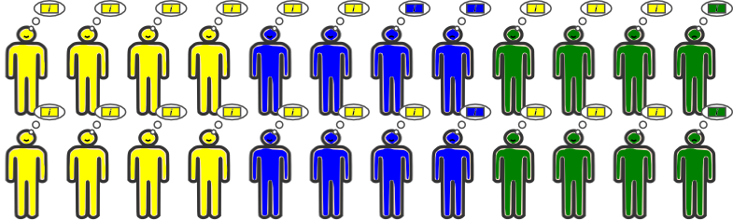
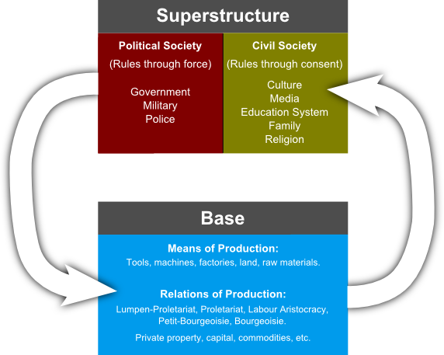
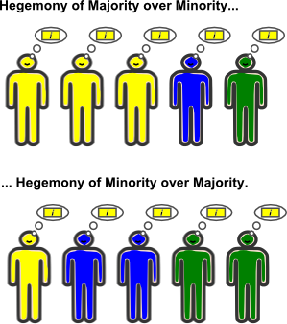
Cultural hegemony
Antonio Gramsci: division of the superstructure into political sphere of law and coercion, and civil society (where ideological content is produced and legitimises the dominance of one group over the rest in their own minds.
Cultural hegemony –each “type of person” naturally possesses an expression of its own values and interests, but the subtle imposition of a dominant ideology or culture creates a common-sense worldview of all.
False Consciousness imposed by religion and authority -- of not knowing how bad they have it or not realizing they have the power to change it
https://integralaxis.wordpress.com/2017/10/14/gramscis-notion-of-cultural-hegemony/

Slide 6
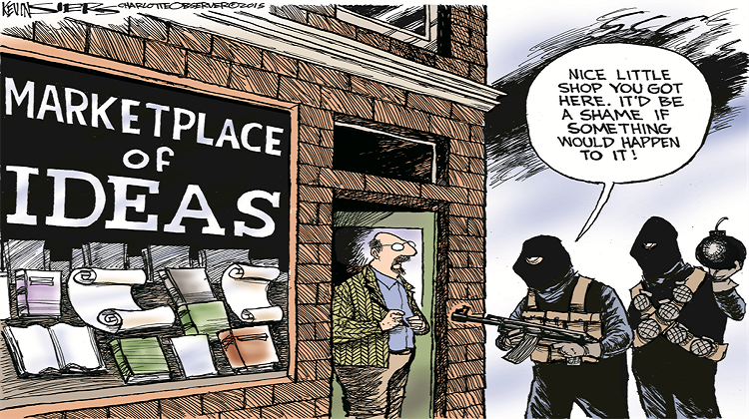
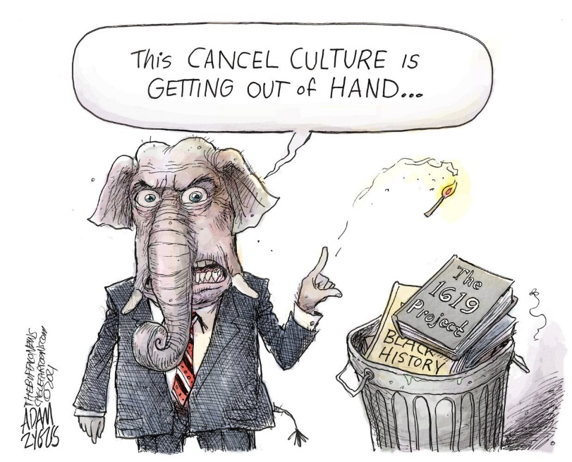
ii. Critics of critical theory
Cancel Culture: a culture in which people are quick to take offense and to demand punishment from the “offender” (Kenan Malik)
“if one’s subjective experience is raised to the status of a godhead…then any perceived verbal offense could be construed as …violent towards the self. Since the words a person uses…cause harm it is therefore rational to pass laws to limit the rights of those using said words” – Reza Zial, “My Apostasy from the Church of Critical Theory”, Areo (2017)
Portrayed as leftwing “woke” phenomenon, conservatives are equally mired in it, denouncing some & defending others (Kenan Malik)
It’s not enough to point to the hypocrisy of the right. It’s also important for the left to defend the right to say objectionable or controversial things. If we don’t defend that right for speech we dislike, we will lose it for the speech we do like.
The Case for a Liberal Approach (Merrick & Hedges 2021)
Promote Common Humanity, Viewpoint Diversity to promote critical thinking, dialogue and mutual understanding, not blaming and shaming
Critical Theory a “radical, social justice oriented philosophy…illiberal activist agenda to remake society “ with little or no assessment of its accuracy to describe history nor its efficacy in the solutions to societal problems
https://headbirths.wordpress.com/2018/08/19/the-shape-of-politics/
https://areomagazine.com/2017/05/30/my-apostasy-from-the-church-of-critical-theory/
https://shenviapologetics.com/intro-to-critical-theory/
https://schoolleader.typepad.com/school-leader/2020/08/fighting-racism-rejecting-critical-theory.html

Slide 7
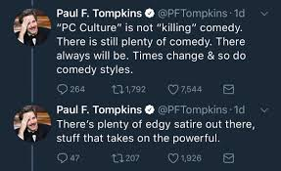
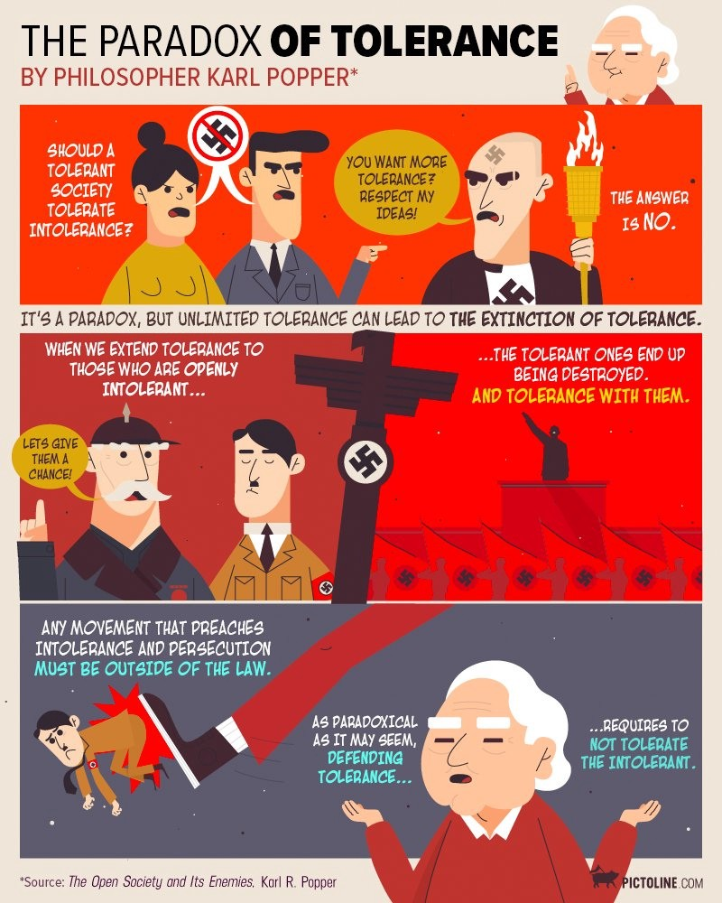
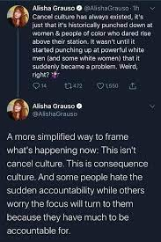
Critics of the critics of critical theory: Cancel culture OR CONSEQUENCE CULTURE?
Harm Principle Revisited: hurt feelings, psychological harm or down-stream economic and physical harm tied to discrimination from harmful stereotypes
Accountability and the relative virtue of punching up vs. punching down
Paradox of Tolerance: should a tolerant person tolerate the intolerant, and wouldn’t intolerance of the intolerant make you intolerant?
https://theconversation.com/culture-wars-uncovered-most-of-uk-public-dont-know-if-woke-is-a-compliment-or-an-insult-161529

Slide 8
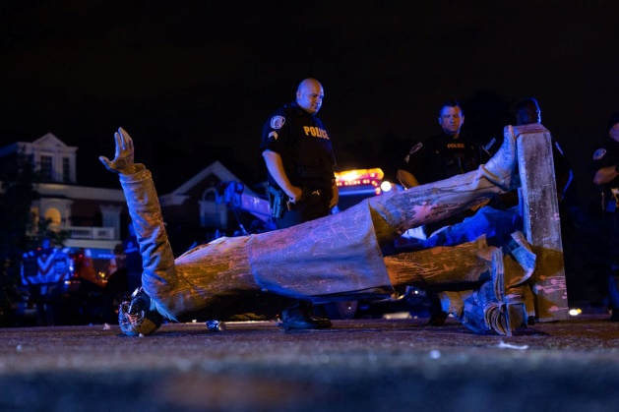
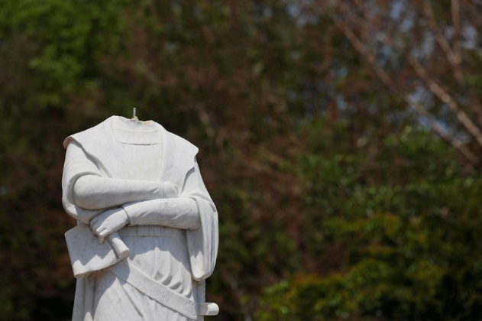
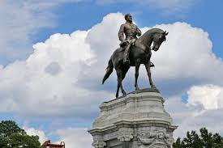
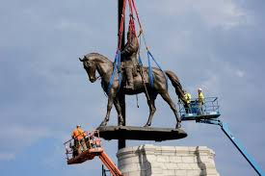
How much to “cancel” and by what process?
Who Decides what is inappropriate?
Elected Officials and Courts?
Majority Public opinion
Opinion of targeted, offended community?
Social media trending
What measures are appropriate to deal with the inappropriate?
Apologies
Whatever the law currently entails
Statue removal, relocation
Impeachments, resignations
By what process is the inappropriateness addressed?
Legal means and processes
Social media
The Case of Statues:
Richmond’s Jeffereson Davis Statue pulled down by protesters
Richmond’s Lee Statue: Virginia Gov. Ralph Northam called for its removal. Virginia Supreme Court upheld decision against legal challenge. Headed for storage 2021.
https://www.theatlantic.com/photo/2020/07/photos-statues-removed-george-floyd-protests-began/613774/
https://www.npr.org/2021/09/08/1035004639/virginia-ready-to-remove-massive-robert-e-lee-statue-following-a-year-of-lawsuit

Slide 9
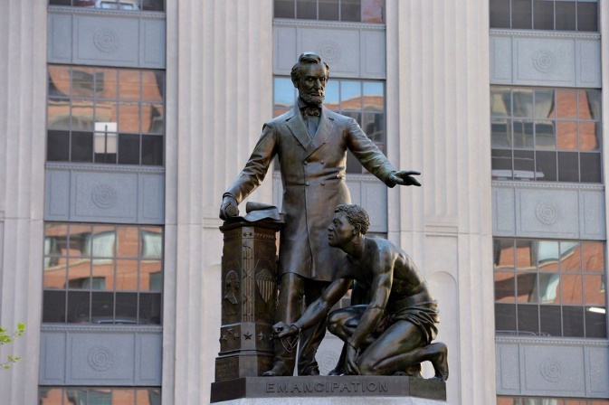
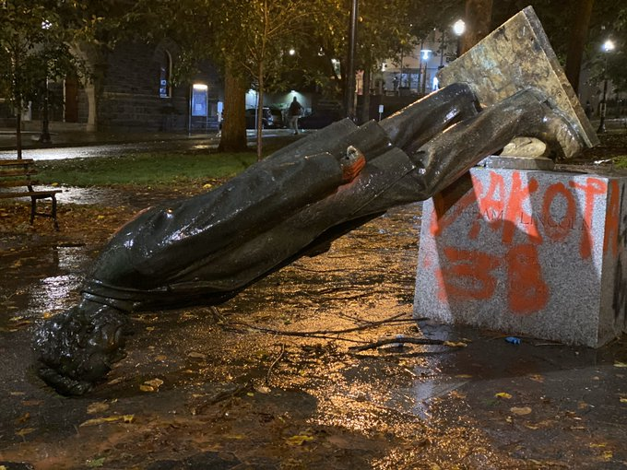
How much to “cancel” and by what process?
Who Decides what is inappropriate?
Elected Officials and Courts?
Majority Public opinion
Opinion of targeted, offended community?
Social media trending
What measures are appropriate to deal with the inappropriate?
Apologies
Whatever the law currently entails
Statue removal, relocation
Impeachments, resignations
By what process is the inappropriateness addressed?
Legal means and processes
Social media
The Case of Statues:
Lincoln statue by vote of the Boston Art Commission
Lincoln in Portland by protesters
https://www.theatlantic.com/photo/2020/07/photos-statues-removed-george-floyd-protests-began/613774/
https://www.npr.org/2021/09/08/1035004639/virginia-ready-to-remove-massive-robert-e-lee-statue-following-a-year-of-lawsuit
https://www.opb.org/article/2020/10/12/portland-protesters-tear-down-roosevelt-lincoln-statues-during-day-of-rage/

Slide 10
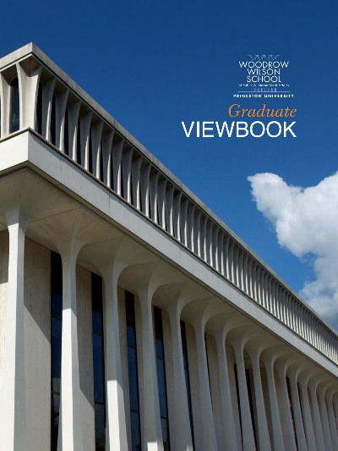
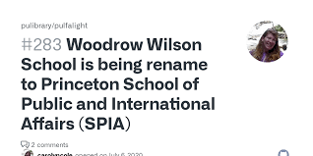
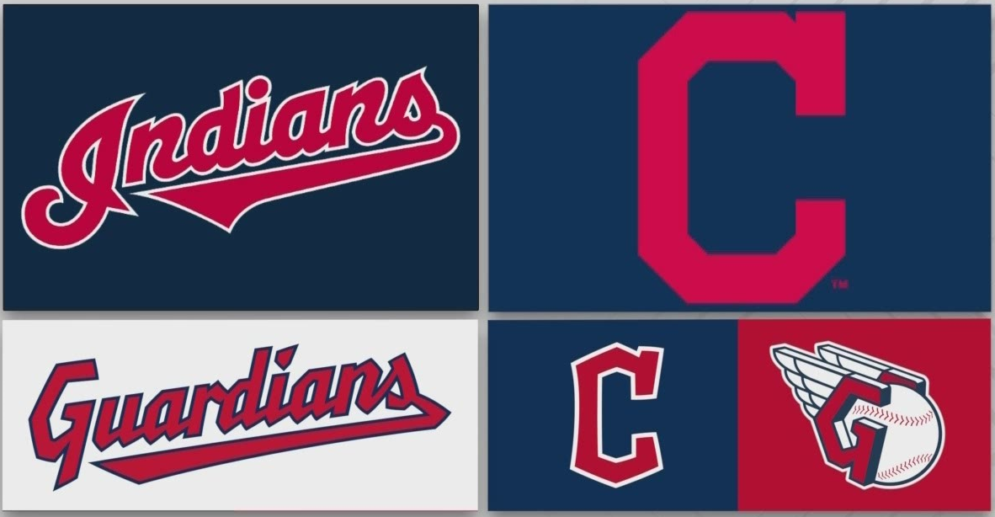
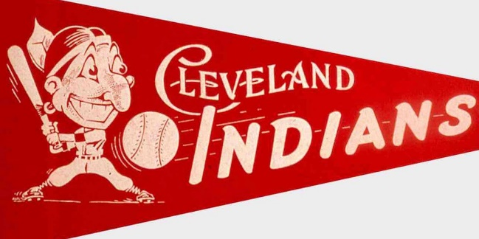
How much to “cancel” and by what process?
Who Decides what is inappropriate?
Elected Officials and Courts?
Majority Public opinion
Opinion of targeted, offended community?
Social media trending
What measures are appropriate to deal with the inappropriate?
Apologies
Whatever the law currently entails
Statue removal, relocation
Impeachments, resignations
By what process is the inappropriateness addressed?
Legal means and processes
Social media
The Case of Renaming
Princeton’s Woodrow Wilson School
Cleveland Indians to Guardians
https://www.theatlantic.com/photo/2020/07/photos-statues-removed-george-floyd-protests-began/613774/
https://www.npr.org/2021/09/08/1035004639/virginia-ready-to-remove-massive-robert-e-lee-statue-following-a-year-of-lawsuit

